Slide 1
Digital Image Processing Chapter 3: Intensity Transformation and Spatial Filter
Notes:
1

Slide 2
Contents
What is image enhancement?
Different kinds of image enhancement
Point processing
Histogram processing
Spatial filtering
Image restoration/reconstruction

Slide 3
What is Image Enhancement?
Image Enhancement: accentuation - sharpening, of image features such as edges, boundaries, or contrast to make a graphic display more useful for display & analysis.
The enhancement process does not increase the inherent information content in the data. But it does emphasize certain specified image characteristics so that they can be detected easily.
Image Enhancement: useful in feature extraction, image analysis & visual information display

Slide 4
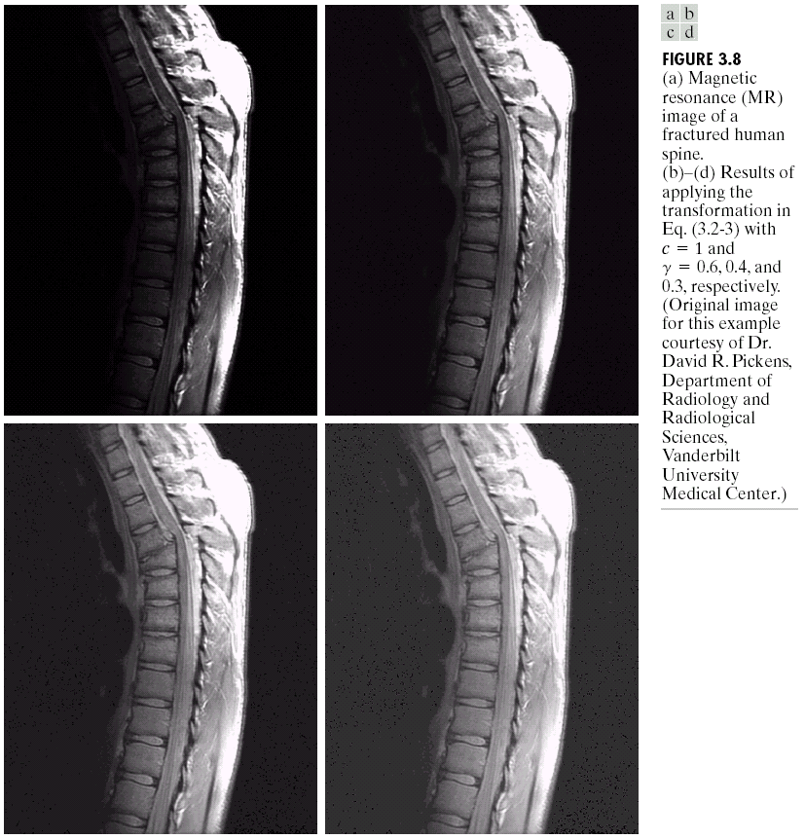
Examples of Image Enhancement
Magnetic resonance image (MRI) of a fractured human spine
and an enhanced image

Slide 5
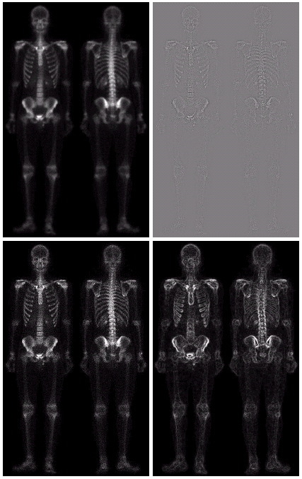
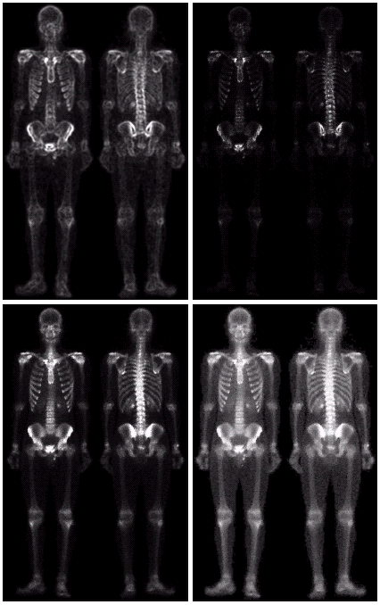
Examples of Image Enhancement
Image of whole body bone scan (from front and back)

Slide 6
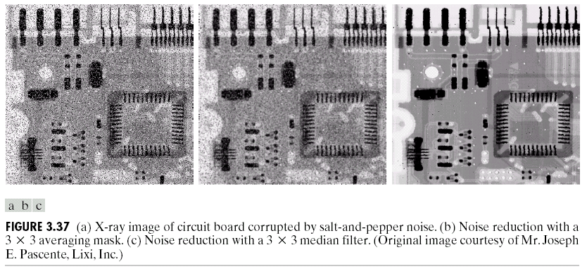
Examples of Image Enhancement
An image of an electronic board

Slide 7
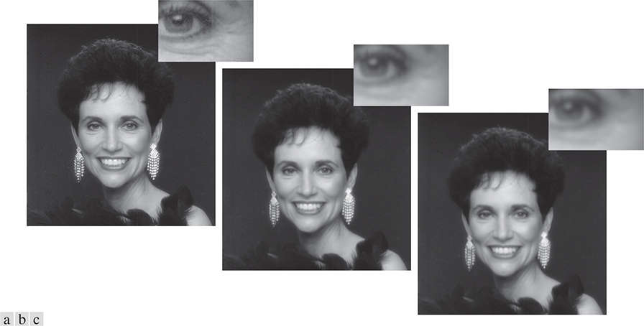
Examples of Image Enhancement
(a) Original image. (b) & (c) Different results of image enhancement.
Note the reduction in fine skin lines in the magnified sections in (b) & (c)

Slide 8
About Image Enhancement
Image enhancement techniques can be divided into two broad categories:
Spatial domain methods: operate directly on pixels
Frequency domain methods: operate on the Fourier transform of an image
Two principal categories of spatial domain methods:
Intensity transformations: operate on single pixels of an image for tasks such as contrast manipulation and image thresholding.
Spatial filtering: performs operations on the neighborhood of every pixel in an image.

Slide 9
About Image Enhancement
There is no general theory for determining what is `good' image enhancement when it comes to human perception.
When techniques are used as pre-processing tools, quantitative measures can determine which techniques are most appropriate.
This course mainly focus on spatial domain techniques.

Slide 10
Image Enhancement using Point Operations

Slide 11
Intensity Transformations
The spatial domain processes we discuss in this chapter are based on the expression: g(x,y) = T[f(x,y)]
f(x, y): an input image
g(x, y): the output image
T: an operator on f defined over a neighborhood of point (x, y).
Origin
x
(x, y)
y
Image f(x, y)

Slide 12
Contents
We will look at image enhancement point processing techniques:
What is point processing?
Negative images
Thresholding
Logarithmic transformation
Power law transforms
And some other transforms

Slide 13
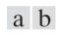
Intensity Transformations
If g depends only on the value of f at a single point (x, y), T becomes an intensity (also called a gray-level, or mapping) transformation function of the form:
s = T(r)
s, r: the intensity of g & f at any point (x, y)
Intensity transformation functions
(a) Contrast stretching function. (b) Thresholding function

Slide 14
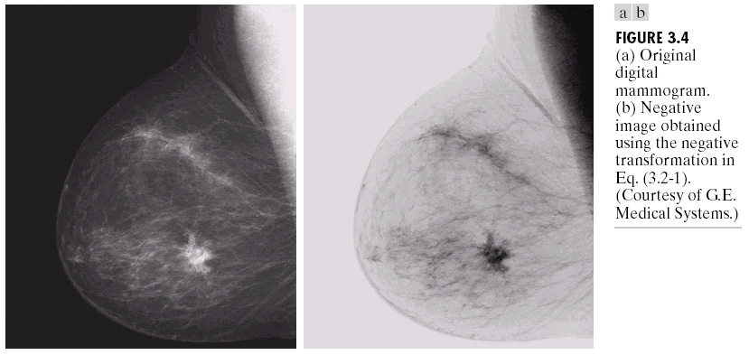
Image Negatives
The negative of an image with intensity levels in the range [0, L-1] is obtained by using the negative transformation function: s = T(r) = L - 1 - r
It is used, for example, in enhancing white or gray detail embedded in dark regions of an image, especially when the black areas are dominant in size.
A digital mammogram and its negative image

Slide 15
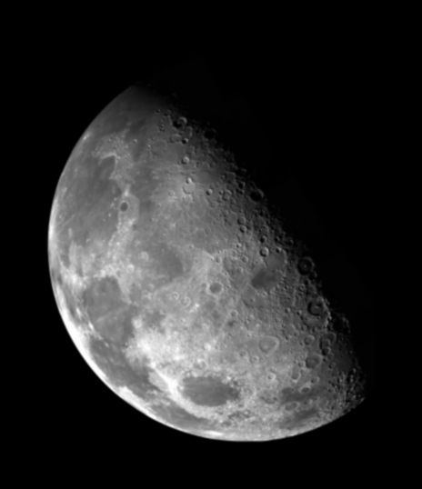

Thresholding
1.0 r > threshold
s =
0.0 r <= threshold
Thresholding creates a binary image from a grayscale or full-color image. This is typically done in order to separate "object" or foreground pixels from background pixels to aid in image processing.
(left) An image of the North Pole of the moon. (right) A thresholded image

Slide 16
Intensity Transformation Functions
Some basic intensity transformation functions:
Linear (negative & identity transformations)
Logarithmic (log & inverse-log transformations)
Power-law (n^{th} power & n^{th} root transformations).

Slide 17
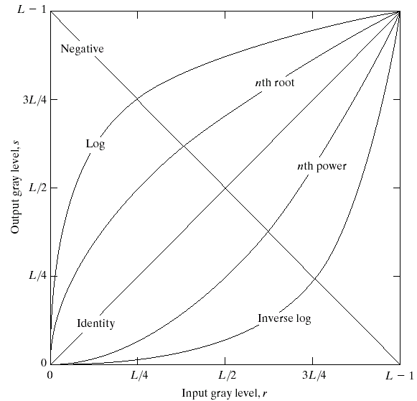
Intensity Transformation Functions
Some basic intensity transformation functions.
Each curve was scaled independently so that all curves would fit in the same graph.
Our interest here is on the shapes of the curves, not on their relative values.

Slide 18
Log Transformations
The general form of the log transformation is:
s = c * log(1 + r)
where c is a constant.
Log transformation maps a narrow range of low intensity values in the input into a wider range of output levels.
For example, note how input levels in the range [0, L/4] map to output levels to the range [0, 3L/4].
Conversely, higher values of input levels are mapped to a narrower range in the output.
It is used to expand the values of dark pixels in an image, while compressing the higher-level values.
The opposite is true of the inverse log (exponential) transformation.

Slide 19
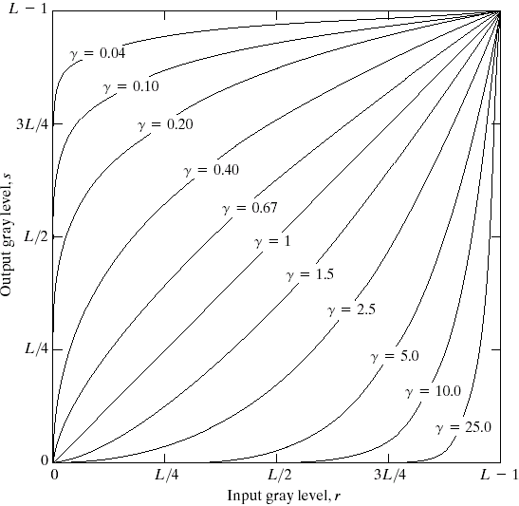
Power-Law (Gamma) Transformations
Power-law transformations have the form:
s = c * r^{γ}
where c and are positive constants
As with log transformations, power-law curves with fractional values of γ map a narrow range of dark input values into a wider range of output values, with the opposite being true for higher values of input levels
The figure shows plots of the gamma equation s = c * r^{γ} for various values of γ
(c = 1 in all cases)
Each curve was scaled independently so that all curves would fit in the same graph. Our interest here is on the shapes of the curves, not on their relative values.

Slide 20
Power-Law (Gamma) Transformations
s = r ^{0.6}
s = r ^{0.4}
s = r ^{0.3}
Magnetic resonance image (MRI) of a fractured human spine and results of applying the power-law transformation

Slide 21
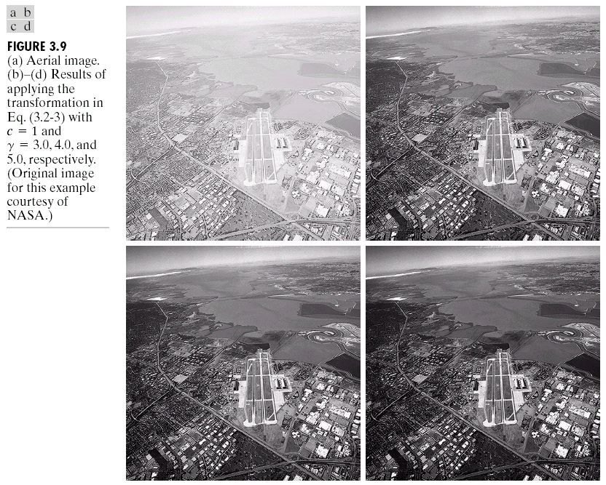
Power-Law (Gamma) Transformations
s = r ^{3.0}
s = r ^{4.0}
s = r ^{5.0}
Aerial image and results of applying the power-law transformation

Slide 22
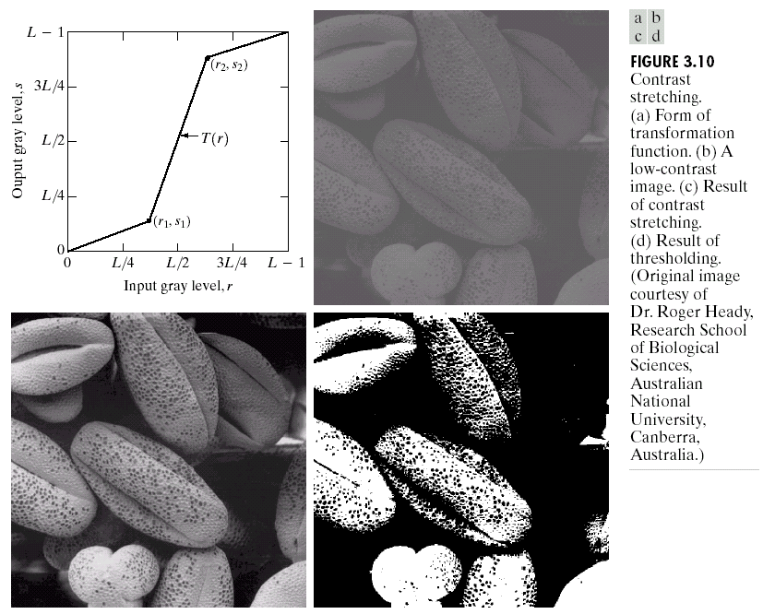
Contrast Stretching
Low-contrast images can result from poor illumination, lack of dynamic range in the imaging sensor, or even the wrong setting of a lens aperture during image acquisition.
Contrast stretching expands the range of intensity levels in an image so that it spans the ideal full intensity range of the recording medium or display device.
A low-contrast electron microscope image of pollen, magnified 700 times, a piecewise linear transformation function and the result of contrast stretching using the function

Slide 23
Histogram Processing

Slide 24
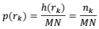
Histogram
Let r_{k} for k = 0, 1, 2, …, L − 1, denote the intensities of an L-level digital image, f(x, y). The unnormalized histogram of f is defined as:
n_{k}: the number of pixels in f with intensity r_{k} and the subdivisions of the intensity scale are called histogram bins.
Similarly, the normalized histogram of f is defined as:
M & N: the number of image rows & columns, respectively.
Mostly, we work with normalized histograms. We refer to simply as histograms or image histograms.

Slide 25
Histogram
Histograms show an overall idea about the intensity distribution of an image.
The sum of p(r_{k}) for all values of k is always 1.
The components of p(r_{k}) are estimates of the probabilities of intensity levels occurring in an image.
Histogram manipulation is a fundamental tool in image processing. Histograms are simple to compute and are also suitable for fast hardware implementations, thus making histogram-based techniques a popular tool for real-time image processing.

Slide 26
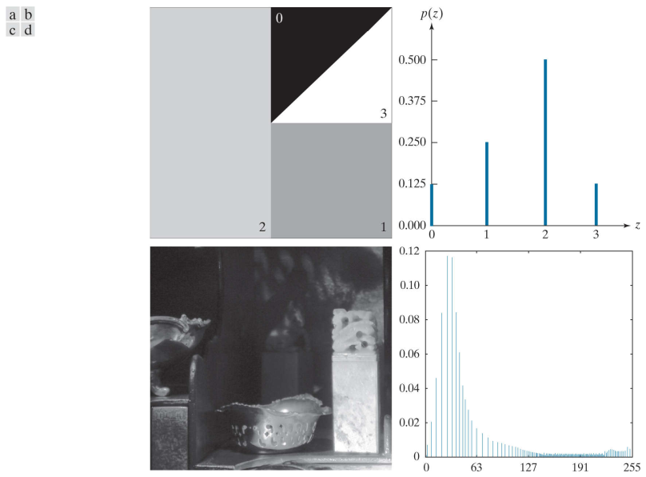
Examples of Image Histograms
(a) A synthetic image, (b) its histogram. (c) A natural image, (d) its histogram
Notes:
26

Slide 27
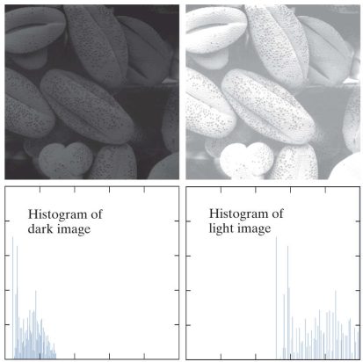
Examples of Image Histograms
Notes:
27

Slide 28
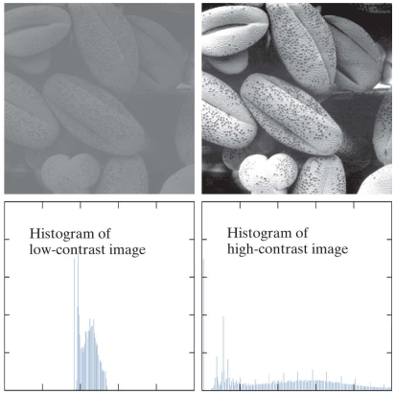
Examples of Image Histograms
Notes:
28

Slide 29
Histogram Equalization
Histogram Equalization: a technique by which the gray-level distribution of an image is changed in such a way as to obtain a uniform (flat) resulting histogram, in which the percentage of pixels of every gray level is the same.
To perform histogram equalization, a transformation function, T(r) is used. Such transformation function must satisfy two criteria:
T(r) must be a monotonically increasing function in the interval 0 ≤ r ≤ L − 1.
0 ≤ T(r) ≤ L − 1 for 0 ≤ r ≤ L − 1

Slide 30
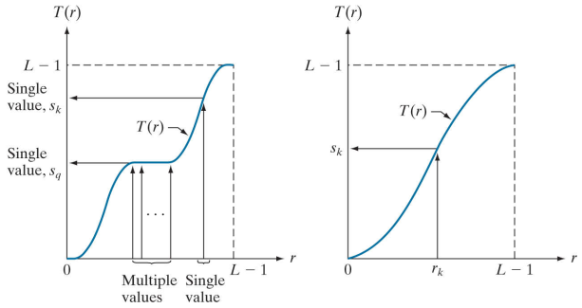
Histogram Equalization
A monotonic increasing function, showing how multiple values can map to a single value; a strictly monotonic increasing function (one-to-one mapping, both ways)

Slide 31
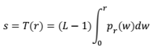
Histogram Equalization
The most usual transformation function T(r) is the Cumulative Distribution Function - CDF of the original normalized histogram function:
where s_{k} is the new (mapped) gray level for all pixels whose original gray level used to be r_{k}; n = M x N; typically L’ = L

Slide 32
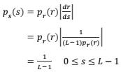
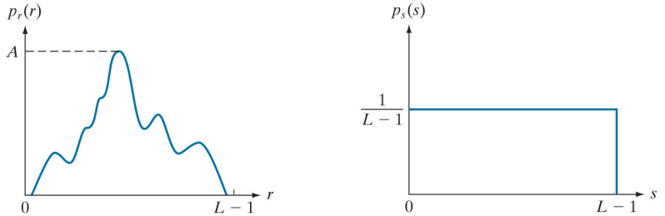
Histogram Equalization
Note that the histogram p_{s}(s) of the image after histogram equalization is uniform as shown on the right:
An arbitrary PDF; result of histogram equalization, the resulting PDF is always uniform, independently of the shape of the input.

Slide 33
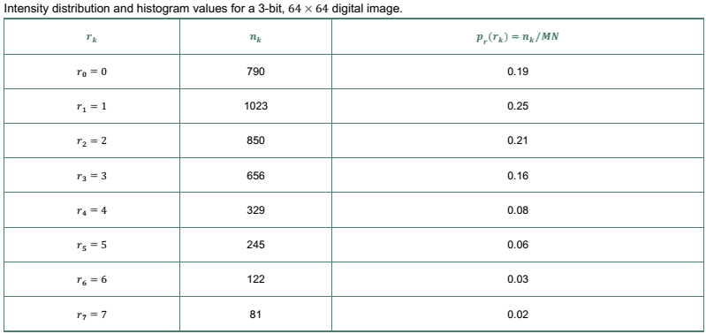
Histogram Equalization: Example
Suppose that a 3-bit image of size 64 x 64 pixels (M x N = 4096) has the intensity distribution in the table below:

Slide 34
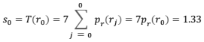
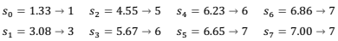
Histogram Equalization: Example

Slide 35
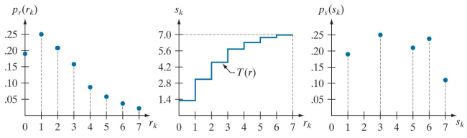
Histogram Equalization: Example
Histogram equalization
Original histogram, transformation function & transformed s_{k}, equalized histogram

Slide 36
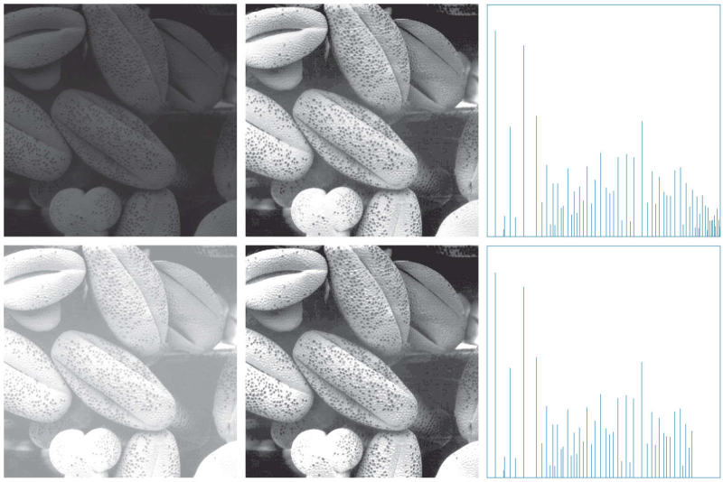
Histogram Equalization: Example
Original image, image after histogram equalization, histogram of the new image

Slide 37
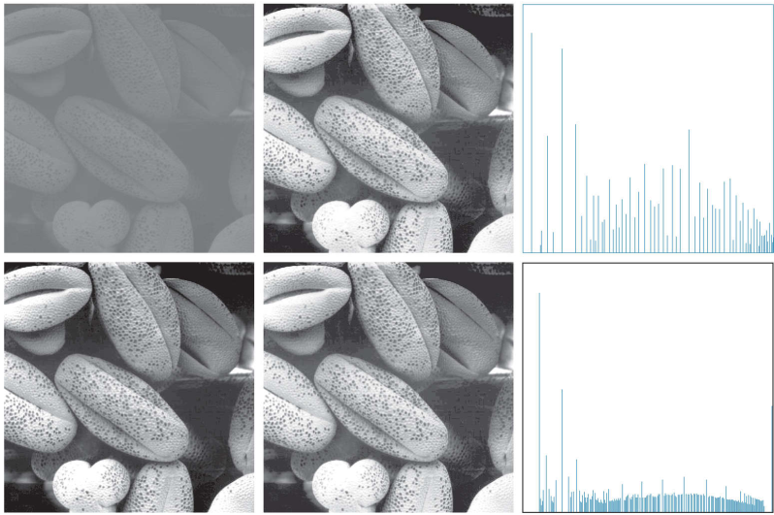
Histogram Equalization: Example
Original image, image after histogram equalization, histogram of the new image

Slide 38
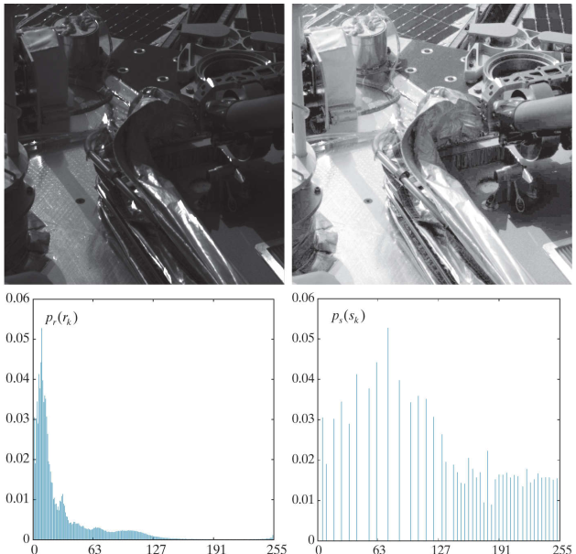
Histogram Equalization: Example
Original image, image after histogram equalization, histogram of the new image

Slide 39
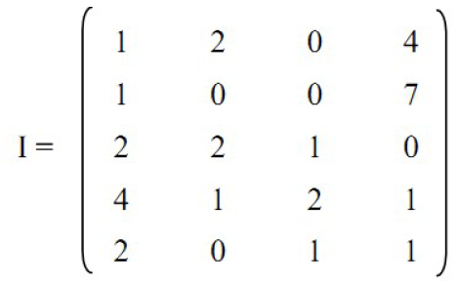
Histogram Equalization: Example
Given image I below (L = 8)
Carry out histogram equalization for I
Show image I’ obtained from I after histogram equalization

Slide 40
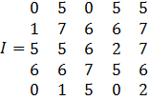
Histogram Equalization: Example
Given image I below (L = 8)
Carry out histogram equalization for I
Show image I’ obtained from I after histogram equalization

Slide 41
Neighborhood Processing - Spatial Filtering S.F. -

Slide 42
Spatial Filtering
In this lecture we will look at spatial filtering techniques:
Neighborhood operations
What is spatial filtering?
Smoothing operations
What happens at the edges?
Convolution
Sharpening filters
Combining filtering techniques
Notes:
42

Slide 43
The Mechanics of Linear S.F.
A linear spatial filter performs a sum-of-products operation between an image f and a filter kernel, w
Origin
x
Image f (x, y)
(x, y)
Neighbourhood
y
Notes:
43

Slide 44
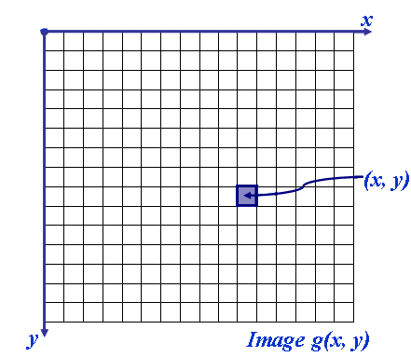
The Mechanics of Linear S.F.
Neighborhood operations operate on a larger neighborhood of pixels than point operations.
Neighborhoods are mostly a rectangle around a central pixel. But any size rectangle and any shape filter are possible
Origin
x
Target
Neighbourhood
(x, y)
y
Image f (x, y)

Slide 45
Simple Neighborhood Operations
Some simple neighborhood operations include:
Min: Set the pixel value g(x, y) to the minimum in the neighborhood
Max: Set the pixel value g(x, y) to the maximum in the neighborhood
Median: The median value of a set of numbers is the midpoint value in that set (e.g. from the set [1, 7, 15, 18, 24] 15 is the median). Sometimes the median works better than the average
Notes:
45

Slide 46
The Spatial Filtering Process
Origin
x
a
b
c
j
k
l
d
e
f
*
m
n
o
g
h
i
p
q
r
Original Image Pixels
Filter (w)
Simple 3*3 Neighbourhood
e
3*3 Filter
e_{processed} = n*e + j*a + k*b + l*c + m*d + o*f + p*g + q*h + r*i
y
Image f (x, y)
The above is repeated for every pixel in the original image to generate the filtered image
Notes:
46

Slide 47
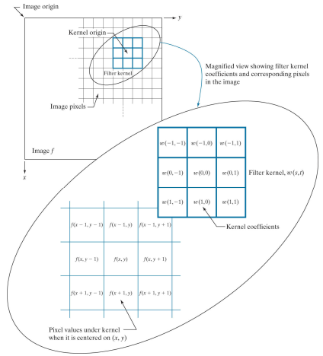
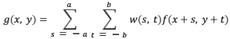
Spatial Filtering: Equation Form
Filtering can be given in the equation form as shown above
Notations are based on the image shown to the left
Notes:
47

Slide 48
Spatial Filtering: Example
= 164*0 + 188*1 + 164*0 + 178*1 + 201*1 + 197*1 + 174*0 + 168*1 + 181*0
= 932

Slide 49
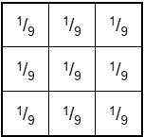
Smoothing Spatial Filters
One of the simplest spatial filtering operations is smoothing operations:
Simply average all of the pixels in a neighborhood around a central value
Useful in removing noise from images
Also useful for highlighting gross detail
Simple
averaging
filter
Notes:
49

Slide 50
Smoothing Spatial Filtering
Origin
x
104
100
108
¹/₉
¹/₉
¹/₉
99
106
98
*
¹/₉
¹/₉
¹/₉
3*3 Smoothing Filter
95
90
85
¹/₉
¹/₉
¹/₉
Original Image Pixels
Filter
¹/₉
¹/₉
¹/₉
Simple 3*3 Neighbourhood
104
100
108
¹/₉
¹/₉
¹/₉
99
106
98
¹/₉
¹/₉
¹/₉
95
90
85
e = ¹/₉*106 + ¹/₉*104 + ¹/₉*100 + ¹/₉*108 + ¹/₉*99 + ¹/₉*98 + ¹/₉*95 + ¹/₉*90 + ¹/₉*85
= 98.3333
y
Image f (x, y)
Notes:
50

Slide 51
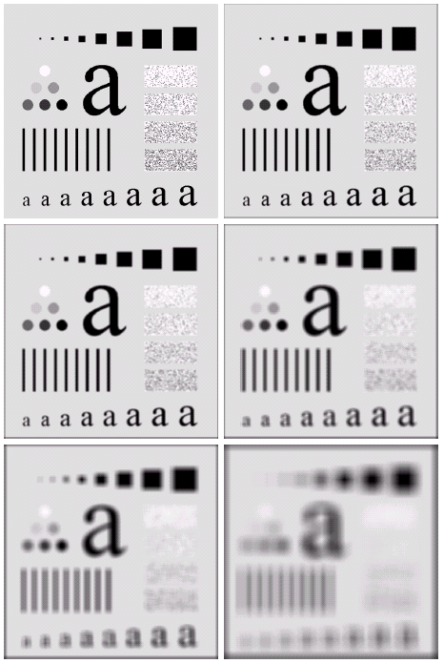
Image Smoothing Example
The image at the top left is an original image of size 500*500 pixels
The subsequent images show the image after filtering with an averaging filter of increasing sizes
3, 5, 9, 15 and 35
Notice how detail begins to disappear
Notes:
51

Slide 52
Weighted Smoothing Filters
More effective smoothing filters can be generated by allowing different pixels in the neighborhood different weights in the averaging function
Pixels closer to the central pixel are more important
Often referred to as a weighted averaging
¹/₁₆ | ²/₁₆ | ¹/₁₆
²/₁₆ | ⁴/₁₆ | ²/₁₆
¹/₁₆ | ²/₁₆ | ¹/₁₆
Weighted averaging filter
Notes:
52

Slide 53
Median Filter
A non-linear spatial filter
It replaces the value of the center pixel by the median of the intensity values in the neighborhood of that pixel.
Median filters provide excellent noise reduction capabilities for certain types of random noise, with considerably less blurring than linear smoothing filters of similar size.
Median filters are particularly effective in the presence of impulse noise (salt-and-pepper noise, i.e. white and black dots on an image)

Slide 54
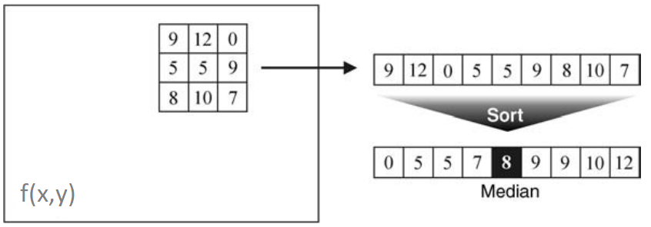
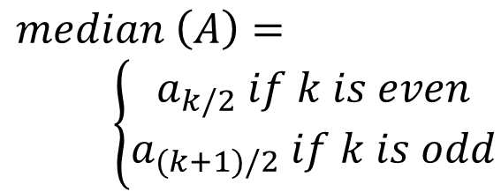
Median Filter
The median of a set of k values is such that half the values in the set are less than or equal to & half are greater than or equal to
In order to perform median filtering at a point in an image, we first sort the values of the pixels in the neighborhood, determine their median, and assign that value to the pixel in the filtered image corresponding to the center of the neighborhood.
$$median \left(A\right)=$$
$\left\{\begin{aligned}a_{k/2} if k is even \\ a_{(k+1)/2} if k is odd\end{aligned}\right.$

Slide 55
Averaging Filter vs. Median Filter
Filtering is often used to remove noise from images
Sometimes a median filter works better than an averaging filter
Original image with noise
After averaging filter
After median filter
Notes:
55

Slide 56
Spatial Filtering at the Image Edge
At the edges of an image we are missing pixels to form a neighborhood
x
Origin
e
e
e
Image f (x, y)
e
e
e
e
y
Notes:
56

Slide 57
Spatial Filtering at the Image Edge
There are a few approaches to dealing with missing edge pixels:
Omit missing pixels:
Only works with some filters
Can add extra code and slow down processing
Pad the image:
Typically with either all white or all black pixels
Replicate border pixels
Truncate the image
Allow pixels wrap around the image
Can cause some strange image artefacts
Notes:
57

Slide 58
Spatial Filter Example
Given the following image with noise
Use the averaging filter and the median filter to de-noise the image
2 | 7 | 3 | 0
3 | 1 | 6 | 3
0 | 1 | 3 | 5
3 | 6 | 7 | 1

Slide 59
Image Restoration and Reconstruction

Slide 60
Image Restoration and Reconstruction
In this lecture we will look at image restoration techniques used for noise removal
What is image restoration?
Noise and images
Noise models
Noise removal using spatial domain filtering
Noise removal using frequency domain filtering
Notes:
60

Slide 61
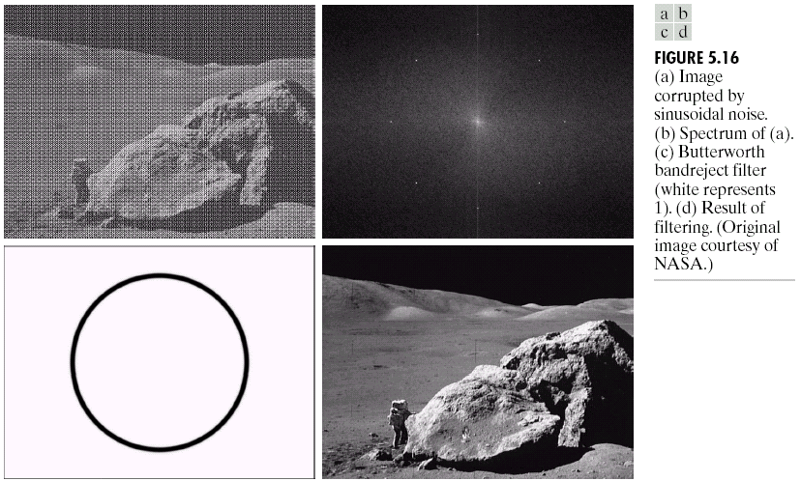
Image Restoration and Reconstruction
Image restoration attempts to restore images that have been degraded
Identify the degradation process and attempt to reverse it
Similar to image enhancement, but more objective
Notes:
61

Slide 62
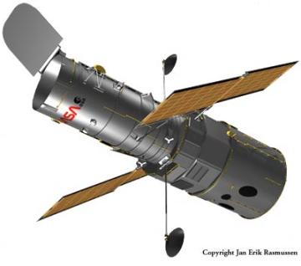
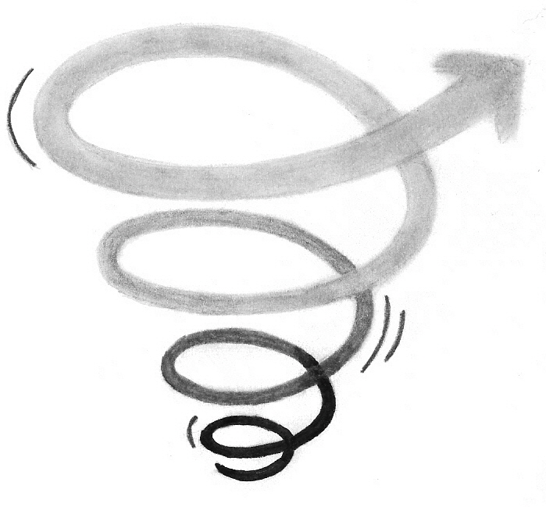
Noise and Images
The sources of noise in digital images arise during image acquisition, digitization & transmission
Imaging sensors can be affected by ambient conditions
Interference can be added to an image during transmission
Notes:
62

Slide 63
Noise Model
We can consider a noisy image to be modelled as follows:
where f(x, y) is the original image pixel; η(x, y) is the noise term and g(x, y) is the resulting noisy pixel
If we can estimate the noise model we can figure out how to restore the image
Notes:
63

Slide 64
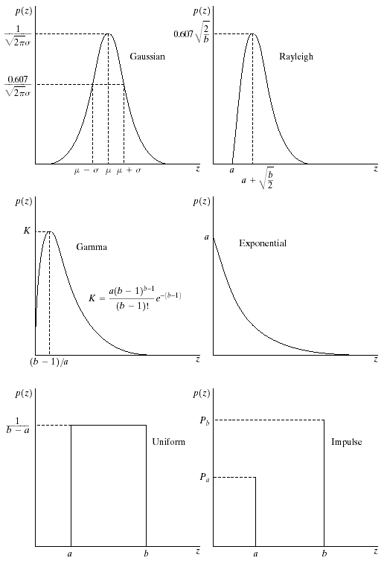
Noise Model
There are many different models for the image noise term η(x, y):
Gaussian
Most common model
Rayleigh
Erlang (Gamma)
Exponential
Uniform
Impulse
Salt and pepper noise
Gaussian
Rayleigh
Erlang
Exponential
Uniform
Impulse
Notes:
64

Slide 65
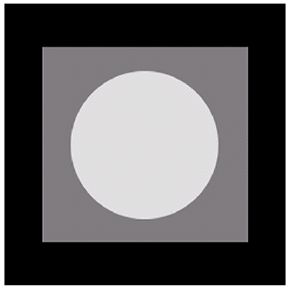
Noise Example
The test pattern below is used for demonstrating the addition of noise.
Different noise models are added to the pattern to show the noise characteristics.
Histogram to go here
Test pattern
Histogram
Notes:
65

Slide 66
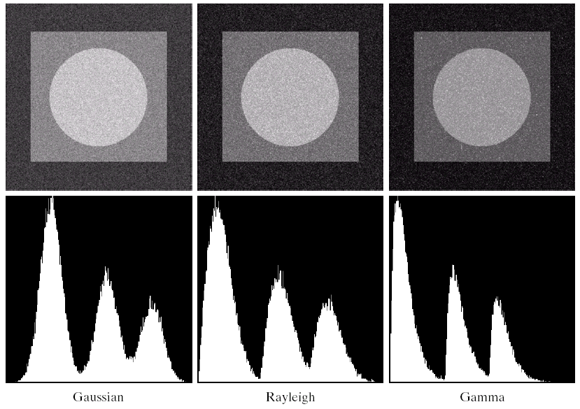
Noise Example
Notes:
66

Slide 67
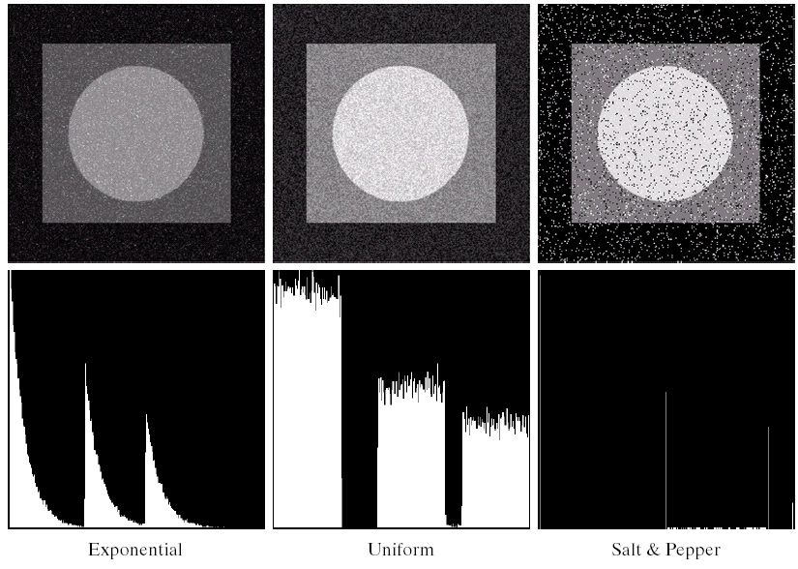
Noise Model
Histogram to go here
Notes:
67

Slide 68
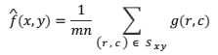
Restoration in the presence of noise only
We can use spatial filters of different kinds to remove different kinds of noise
The arithmetic mean filter is a very simple one and is calculated as follows:
m, n: the image size.
This is implemented as the simple smoothing filter. It blurs the image.
¹/₉ | ¹/₉ | ¹/₉
¹/₉ | ¹/₉ | ¹/₉
¹/₉ | ¹/₉ | ¹/₉
Notes:
68

Slide 69
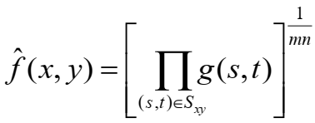
Restoration in the presence of noise only
Geometric Mean:
Achieves similar smoothing to the arithmetic mean, but tends to lose less image detail.
Notes:
69

Slide 70
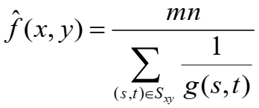
Restoration in the presence of noise only
Harmonic Mean::
Works well for salt noise, but fails for pepper noise.
Also does well for other kinds of noise such as Gaussian noise.
Notes:
70

Slide 71
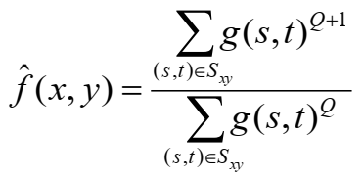
Restoration in the presence of noise only
Contra-harmonic mean:
Q is the order of the filter.
Positive values of Q eliminate pepper noise.
Negative values of Q eliminate salt noise.
It cannot eliminate both simultaneously.
Notes:
71

Slide 72
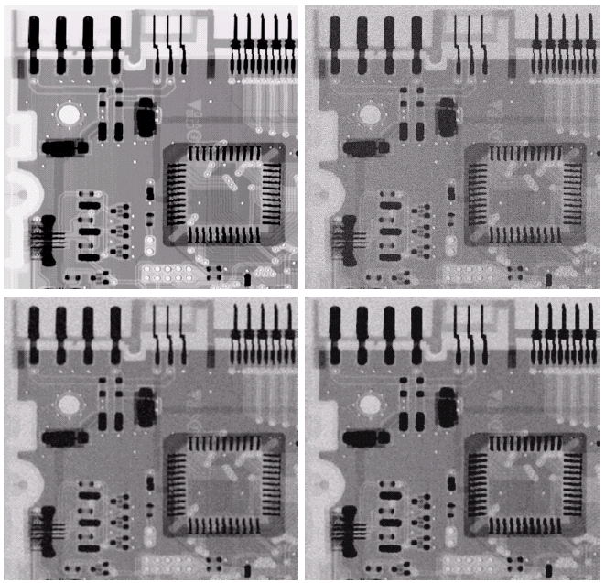
Noise Removal Examples
a, b
c, d
a) Original image; b) Image corrupted by Gaussian noise; c) 3x3 arithmetic mean filter; d) 3x3 geometric mean filter (less blurring than AMF, the image is sharper)
Notes:
72

Slide 73
Some Other Spatial Filters
Spatial filters based on ordering the pixel values that make up the neighborhood defined by the filter support.
Useful spatial filters include:
Median filter
Max and min filter
Midpoint filter
Alpha trimmed mean filter
Notes:
73

Slide 74
Median Filter
Median filter:
Excellent at noise removal, without the smoothing effects that can occur with other smoothing filters.
Particularly good when salt and pepper noise is present.
Notes:
74

Slide 75
Median Filter
Median filter:
Excellent at noise removal, without the smoothing effects that can occur with other smoothing filters.
Particularly good when salt and pepper noise is present.
Notes:
75

Slide 76
Max, Min Filters
Max filter:
Min filter:
Max filter is good for pepper noise and Min filter is good for salt noise.
Notes:
76

Slide 77
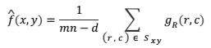
Midpoint & Alpha-Trimmed Mean Filters
Midpoint filter:
Good for random Gaussian and uniform noise
Alpha-trimmed mean filter:
where d is the number of pixel values excluded at each end of the ordered set, d ∈ [0, mn - 1]
Good if there are more than one type of noise
Notes:
77

Slide 78
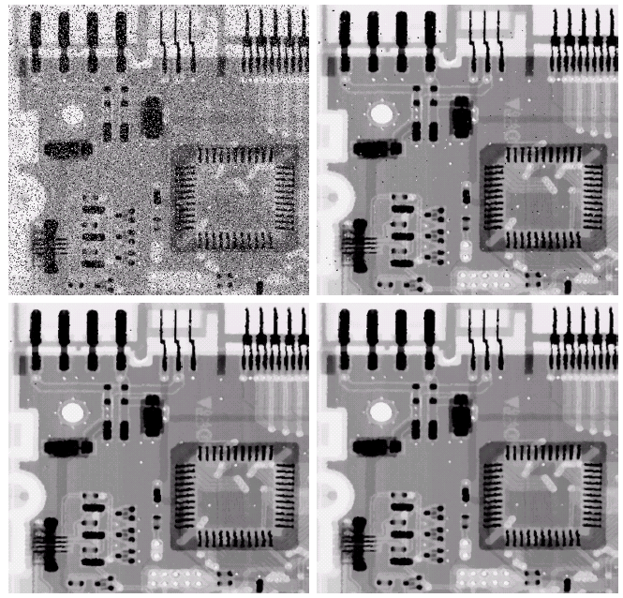
Noise Removal Examples
a, b
c, d
a) Salt and Pepper; b) 1 pass with a 3x3 median; c) 2 passes with a 3x3 median; d) 3 passes with a 3x3 median
Notes:
78

Slide 79


Noise Removal Examples
a, c
b, d
a) Image corrupted by Pepper noise; b) Filtering a) with a 3x3 Max Filter; c) Image corrupted by Salt noise; d) Filtering c) with a 3x3 Min Filter
Notes:
79

Slide 80

Noise Removal Examples
Image corrupted by uniform noise;
Filtering a): 5x5 Arithmetic Mean Filter;
Filtering a): 5x5 Median Filter;
Image a) further corrupted by Salt and Pepper noise;
Filtering d): 5x5 Geometric Mean Filter;
Filtering d): 5x5 Alpha-Trimmed Mean Filter (d=5)
a, d
b, e
c, f
Notes:
80

Slide 81

Periodic Noise
Typically arises due to electrical or electromagnetic interference.
Gives rise to regular noise patterns in an image.
Frequency domain techniques in the Fourier domain are most effective at removing periodic noise.
Notes:
81

